Slide 1
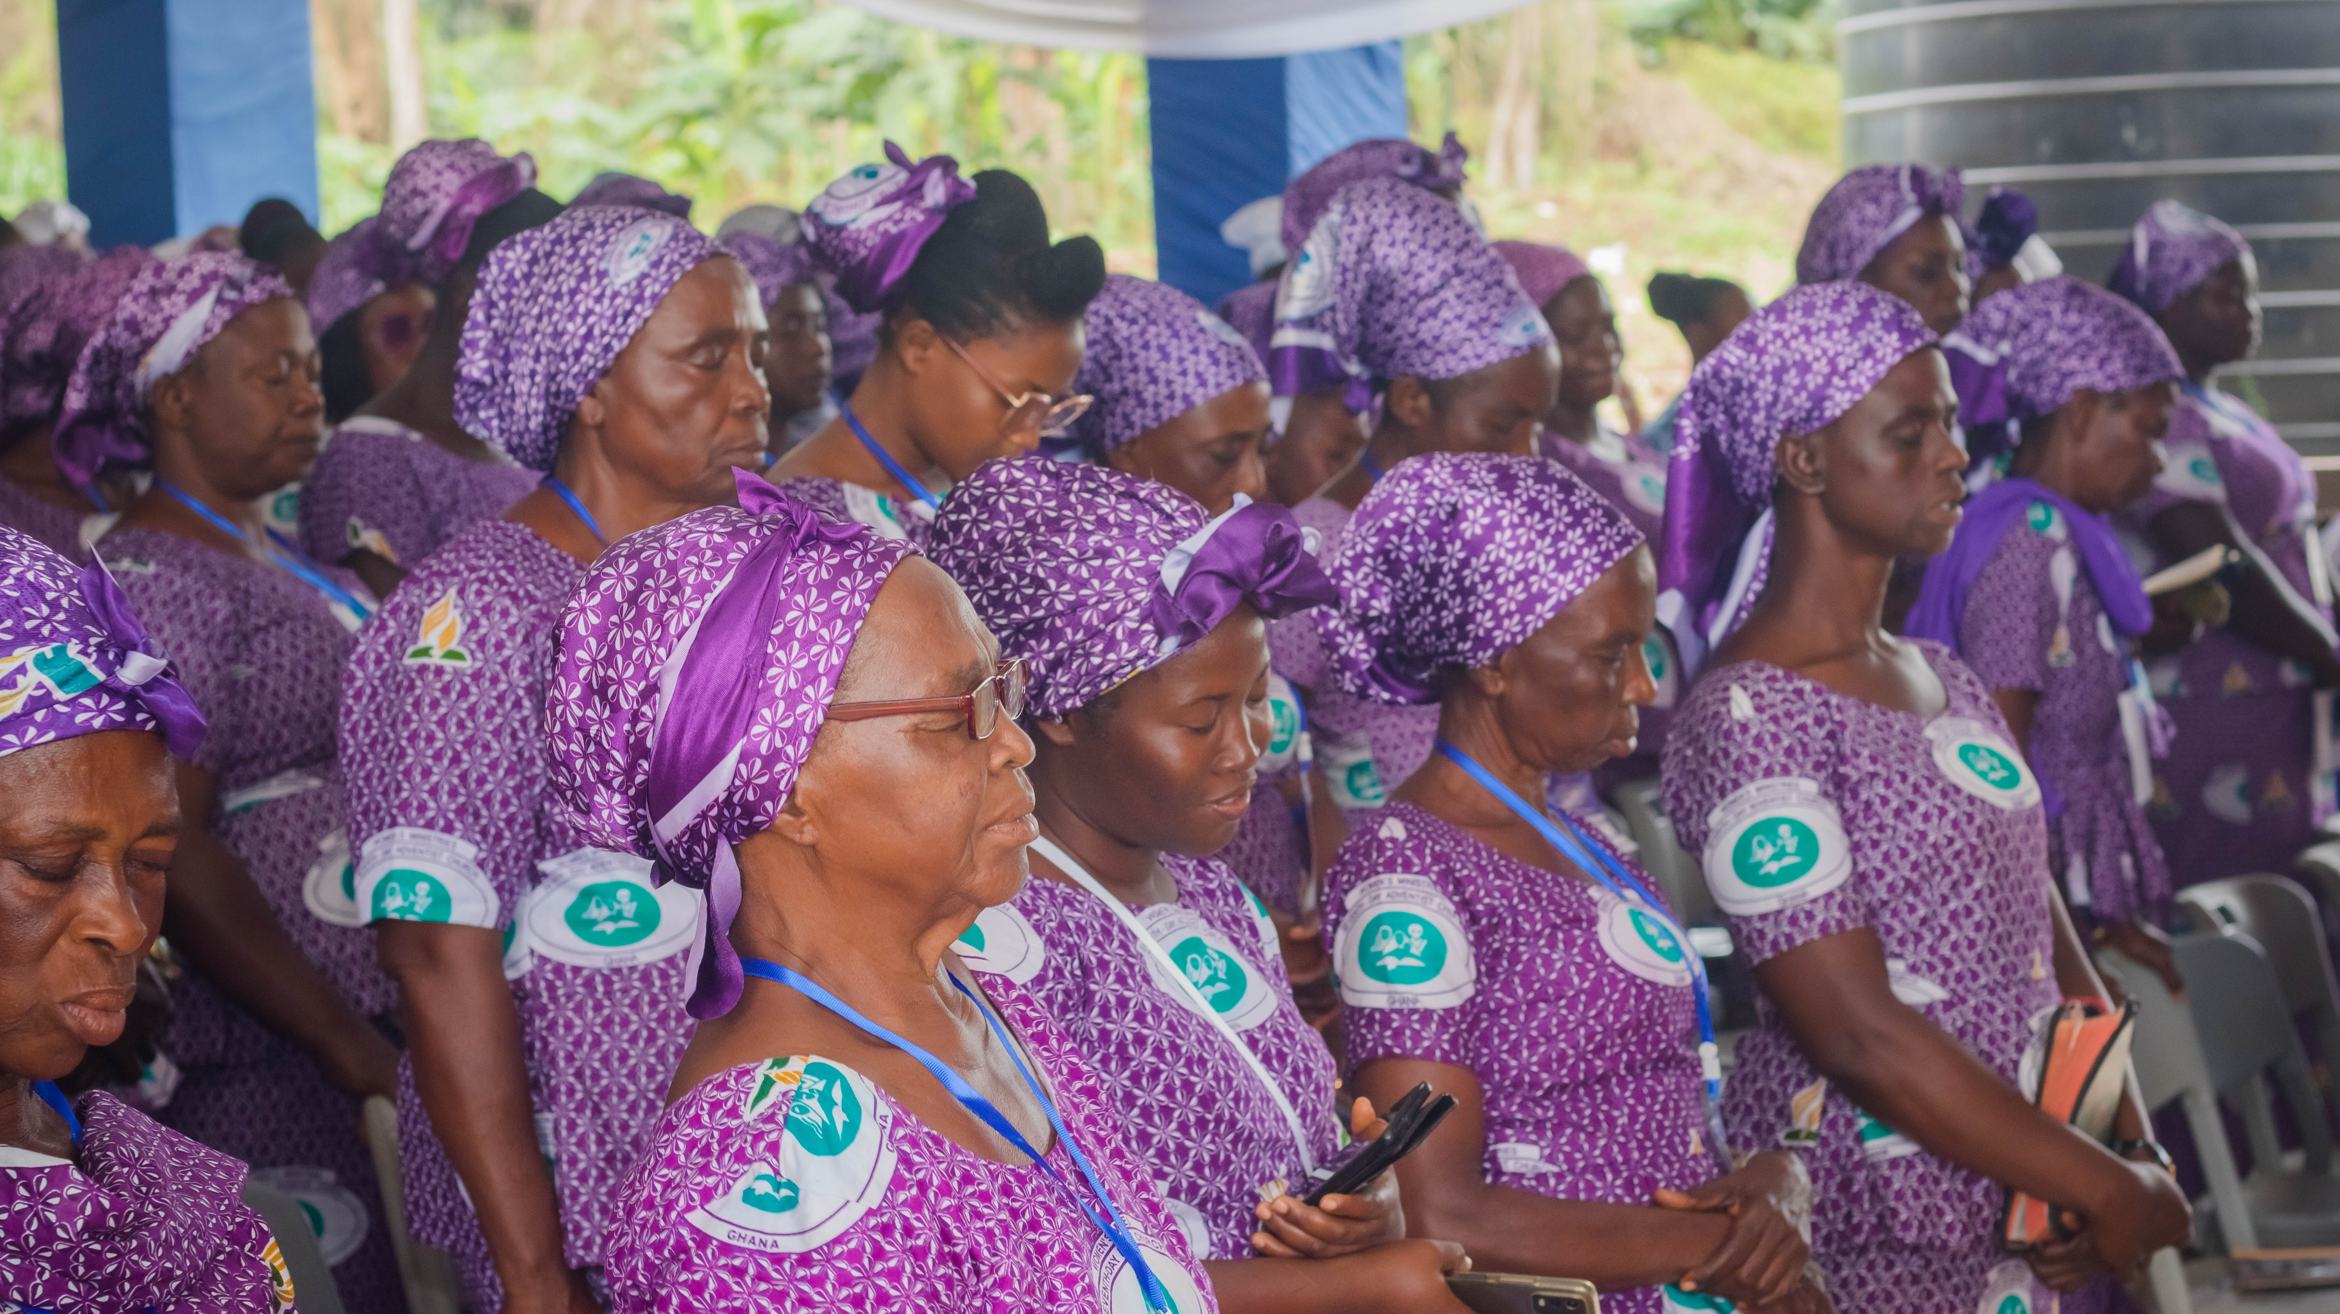
CALLED TO BE FAITHFUL: THE ROLE OF THE ADVENTIST WOMAN
PROVERBS 31:10

Slide 2

Introduction
We are living in solemn times. The call to faithfulness is urgent and real, especially for us as women of the remnant church.
Let us begin with the anchor verse of our faith: Revelation 14:12 – “Here is the patience of the saints: here are they that keep the commandments of God, and the faith of Jesus.”

Slide 3

This message isn’t just for pastors and leaders. It is for you, the Adventist woman — the mother raising children, the single woman managing a business, the grandmother praying for her family, and the student living for Christ on campus. Faithfulness means holding on to God’s truth, walking in obedience, and reflecting the life of Christ in everyday life

Slide 4

“To every woman is given a work to do for the Master. The true woman will have an influence, powerful and far-reaching.”
(Adventist Home, p. 231).
Notes:
For example, Mrs. Ama Attah, a local church deaconess in Cape Coast. She cannot read or write, but faithfully visits members every Sabbath afternoon, prays with them, and shares tracts. Many testify that they remained in the church because of her love. That is faithfulness.

Slide 5
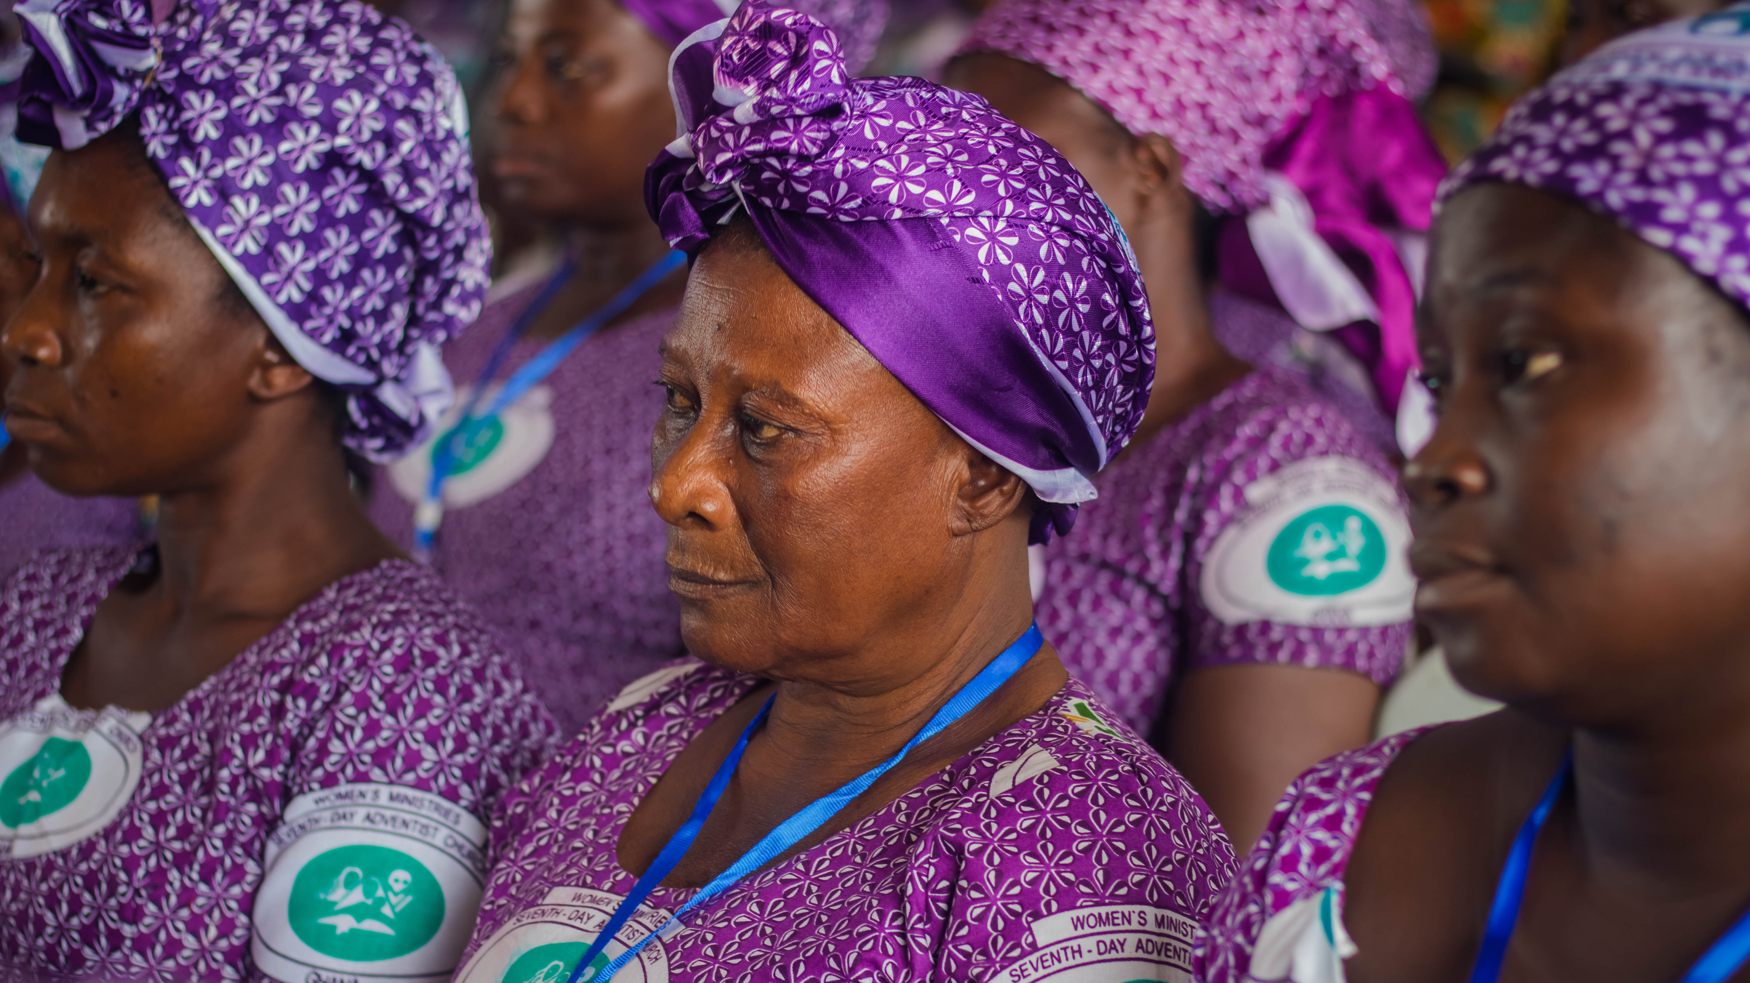
The Adventist Woman As A Virtuous Woman (Proverbs 31:10–31)

Slide 6
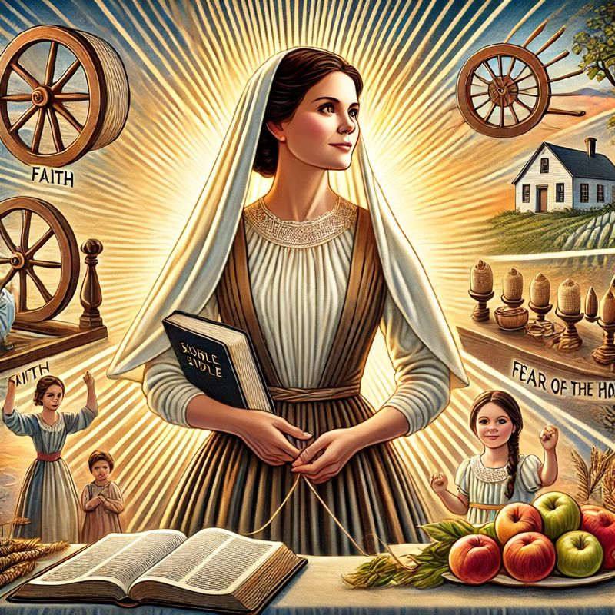
A. Understanding the Proverbs 31 Woman

Slide 7
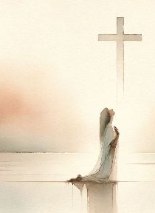
The virtuous woman is strong — not just in physical labor but in spiritual resilience. The Hebrew word “chayil” suggests valor and capability, like that of a warrior. She is prayerful and practical. She is gentle but firm. She is deeply spiritual but also excels in her duties.

Slide 8

“A Christian woman is a powerful force in the home, church, and society when Christ is enthroned in her heart.” –
(Adventist Home, p. 243).

Slide 9
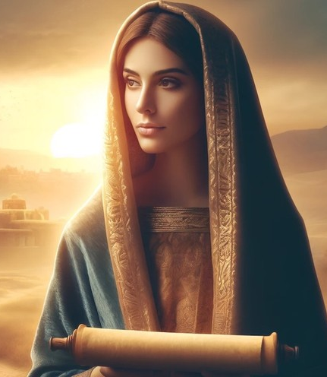
Example:
Abigail in 1 Samuel 25 faced a crisis when her husband Nabal insulted David. With wisdom and courage, she acted quickly to prevent bloodshed. Her character, like the Proverbs 31 woman, saved her household

Slide 10
B. Core Traits of the Faithful Woman
Her character in Proverbs 31:
Spiritual Strength (v. 30)
Compassion and Generosity (v. 20)
Dignity and Grace (v. 25–26
Respected Influence (v. 28–31)
Faithfulness in Duty (v. 13, 17)
Stewardship and Wisdom (v. 16, 24, 27)
Notes:
Spiritual Strength (v. 30) – She fears the Lord. Her life is centered on God, not worldly praise. Example: A young Adventist nurse in Accra begins every shift with prayer, even if mocked by coworkers. Her patients say they feel peace when she cares for them.
Faithfulness in Duty (v. 13, 17) – She works willingly with her hands. She is not idle or wasteful, but diligent. Example: A market woman in Tamale rises at dawn, prepares meals for her children, sells ethically, and still leads the Dorcas Society in her church.
Stewardship and Wisdom (v. 16, 24, 27) – She considers a field and buys it. She plans, saves, invests, and avoids waste. Example: A widow in Kumasi uses microfinance to start a tailoring shop and 7now sponsors three needy children in school.
Compassion and Generosity (v. 20) – She stretches out her hand to the poor. Her heart and home are open. Example: An Adventist woman in Takoradi opens her home every Sabbath to students who cannot afford food. She treats them as her own.
Dignity and Grace (v. 25–26) – She is clothed with strength and speaks wisely. Her words bless, not break; she uplifts others. Example: A church elder’s wife mediates conflicts in the women’s ministry with calm words and prayer. She is respected because she is peacemaking.
Respected Influence (v. 28–31) – Her children and husband rise and call her blessed. Her impact is lasting, not fleeting. Example: During a funeral in Ho, the children of a late Adventist woman testify how her faith, morning worship, and songs kept them grounded. Many wept — her legacy still speaks.

Slide 11

CALLED TO BE FAITHFUL IN THREE KEY DOMAINS

Slide 12

In the Home: A Nurturer of Faith and Character
The home is where the woman’s influence is most felt. Her values shape the future of her children. “The greatest evidence of the power of Christianity that can be presented to the world is a well-ordered, well-disciplined family.” (Adventist Home, p. 32). Deuteronomy 6:6–7:
“Teach them diligently to your children…”

Slide 13
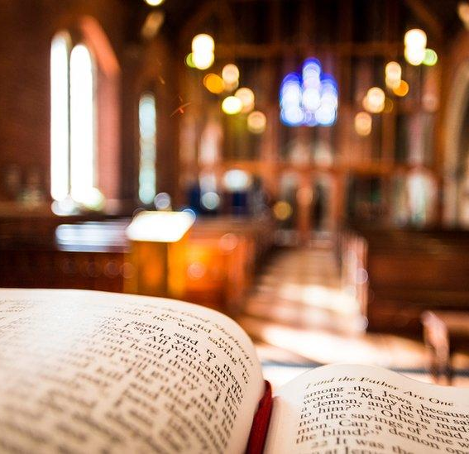
In the Church: A Committed Steward and Servant
Adventist women have a calling to serve in God’s church — not in silence, but in Spirit-led ministry. “The Lord has a work for women as well as men to do.” – (Testimonies, Vol. 9, p. 128) . Whether teaching children, leading praise, or visiting the sick, her service is part of God’s mission.
Notes:
Example:In a rural district in Eastern Ghana, women outnumber men in attendance. One sister started a Bible class in her home. Today, the church has grown, and she has mentored three other women to teach.

Slide 14

In Society: A Witness and Light Bearer
The Adventist woman must be salt and light wherever God places her — as a nurse, teacher, trader, lawyer, or farmer. Titus 2:3–5: “Teach younger women to be sober, love their husbands, and be keepers at home…”“A cheerful spirit and heart full of love will make her a blessing in society.” (AH, p. 257).
Notes:
Example:An Adventist teacher in Wa refused to alter students’ grades despite bribes. Her honesty led the headmaster to request Bible studies. Today, five staff members have been baptized.

Slide 15

Challenges To Faithfulness In The Last Days

Slide 16
Challenges To Faithfulness In The Last Days
Moral confusion —
Gender roles are blurred.
Busyness —
Some are too tired for devotion or ministry.
Media pressure —
The world defines beauty and success in ungodly ways.
Loneliness —
Some women feel unappreciated or isolated in ministry.

Slide 17

But take courage.
The Lord is our helper!
“In the great final conflict, every soul will be tested… The faithful will shine forth.” –
(Prophets and Kings, p. 188).
Notes:
Example: A young Adventist woman in university was mocked for not joining parties. But years later, her former roommate, pregnant and depressed, called her for prayer. She said, “I knew you were different

Slide 18
The Reward Of Faithfulness
Matthew 25:21 – “Well done, thou good and faithful servant…”
Proverbs 31:31 – “Give her of the fruit of her hands…”
2 Timothy 4:7–8 – “There is laid up for me a crown of righteousness…”
Notes:
God is not unjust to forget your labor (Heb. 6:10). Heaven sees the tears, the giving, the prayers, the cooking, the late-night intercessions.
Example:At the funeral of an old Adventist woman, children from her Pathfinder class came from afar. One said, “She taught me how to pray and memorize Scripture. Today, I’m a pastor.” Faithfulness multiplies — across generations.

Slide 19

Conclusion
Rise Up, Woman Of God.
You are not called to be perfect — you are called to be faithful.
You may be tired. You may feel hidden. But God sees you.
Isaiah 60:1 – “Arise, shine, for your light has come!”

Slide 20

Today, He calls you — to rise in your home, to rise in your church, to rise in your workplace.
He calls you to reflect His love, to uphold His commandments, and to live the faith of Jesus. You are not alone.
You are equipped. You are chosen.

Slide 21

Let us pray:
“Lord, help me to be faithful — as a mother, a leader, a servant, and Your daughter — living Your commandments and reflecting the faith of Jesus.”

